Slide 1

22 Reasons to move to MySQL 8 And 4 reasons not to
Peter Zaitsev,
Founder at Percona
24 October 2023

Slide 2


Heatwave to melt Snowflake

Slide 3

#1 MySQL 5.7 Goes EOL in October 2023

Slide 4

#2 New Development Process
Get new Features Frequently, Rather than once every 2-3 years

Slide 5

#3 Innodb based Data Dictionary
Atomic, Crash Safe DDLs
Crash Safe Grants
Much Faster Information Schema

Slide 6
#4 More SQL, Better SQL
Window Functions
CTEs (Common Table Expressions)
INTERSECT and EXCEPT
LATERAL JOIN

Slide 7

#5 Better Security
New Authentication Protocol
Support for More Authentication Plugins
Improvements to Transparent Data Encryption (TDE)
Improvements to TLS
Roles

Slide 8

#6 UTF8 Default
And Proper (MB4) UTF8 that is !💕👍😉🧌

Slide 9
#7 All Things Indexes
Functional Indexes
Descending Indexes
Invisible Indexes
Multi Value Indexes (JSON)
Generated Invisible Primary Keys

Slide 10

#8 Better JSON Support

Slide 11

#9 Improved Optimizer
Hash Joins among other things…

Slide 12
#10 Improved EXPLAIN
TREE Format
1
EXPLAIN ANALYZE
2
Default EXPLAIN Format
3

Slide 13

#11 Better Agility
Much more DDLs supported as ALGORITHM=INSTANT

Slide 14

#12 SET PERSIST
New way to control MySQL Configuration

Slide 15
#13 Optimizer Hints
Number of new Hints Supported
SET_VAR to set some variables for query duration only

Slide 16
#14 Resource Management
Resource Groups to Prioritize or Restrict CPU Resources for some queries

Slide 17

#15 NOWAIT an SKIP_LOCKED
Flexible handling of encountered row level locks

Slide 18

#16 Proper AUTO_INCREMENT
Do not loose Auto Increment Counter value in Edge Cases

Slide 19

#17 Temptable Storage Engine
Replaced aging HEAP for In Memory TMP Tables
Supports BLOBS

Slide 20
#18 Undo Space
Separate Dynamically Sized location for Innodb Undo Space

Slide 21
#19 Double Write
Separate Location
Configurable
Detect Only Option

Slide 22
#20 Redo Logs
Dynamically Sizable Online
Can be Disabled for faster data loading

Slide 23
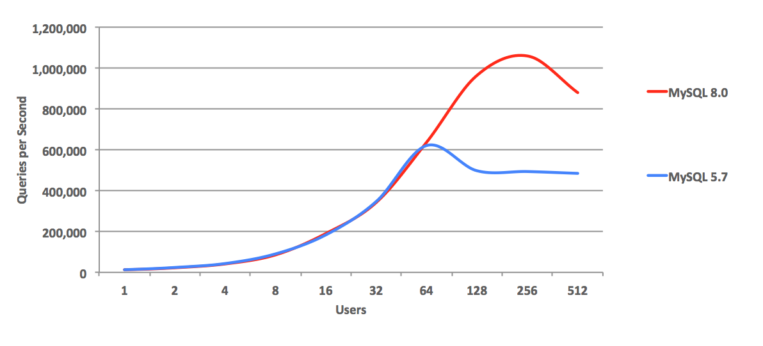
#21 Better Concurrency

Slide 24
#22 User Comments and Attributes
Store Meta-Data about user accounts directly in MySQL

Slide 25

Why not Upgrade to MySQL 8 ?

Slide 26

Heatwave
Is Oracle re-focusing MySQL Development on Proprietary cloud version only?

Slide 27

New Development Process
Lack of Stability
Hard to downgrade
Quality Problems

Slide 28

Performance
Performance at low concurrency with simple queries perceived to be lower

Slide 29

Sharding
No Built In transparent “Scale Out” Option makes developing large scale applications hard

Slide 30

Question
Know Even Better “MySQL” ?

Slide 31



Want to know more about Percona Software For MySQL?
QR Code goes here

Slide 32
Thank you, Let’s connect!
https://www.linkedin.com/in/peterzaitsev/
https://twitter.com/PeterZaitsev
http://www.peterzaitsev.com

